Slide 1


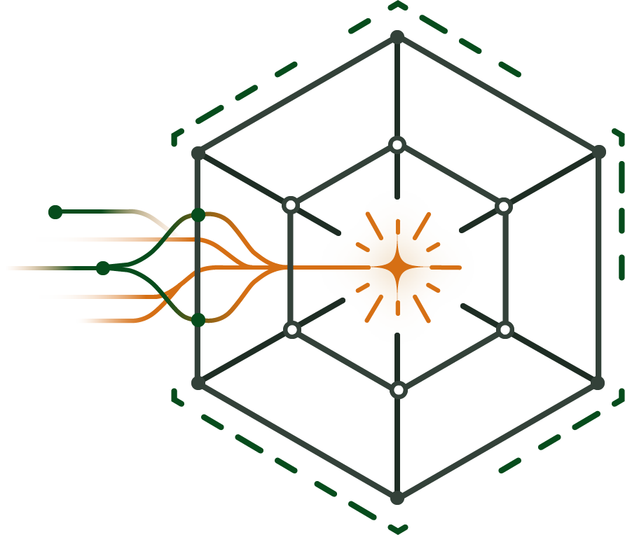


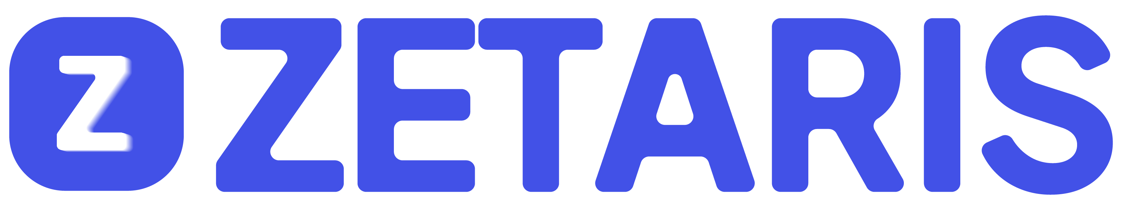


AuraBI
Ask in plain words. See the evidence.

Slide 2
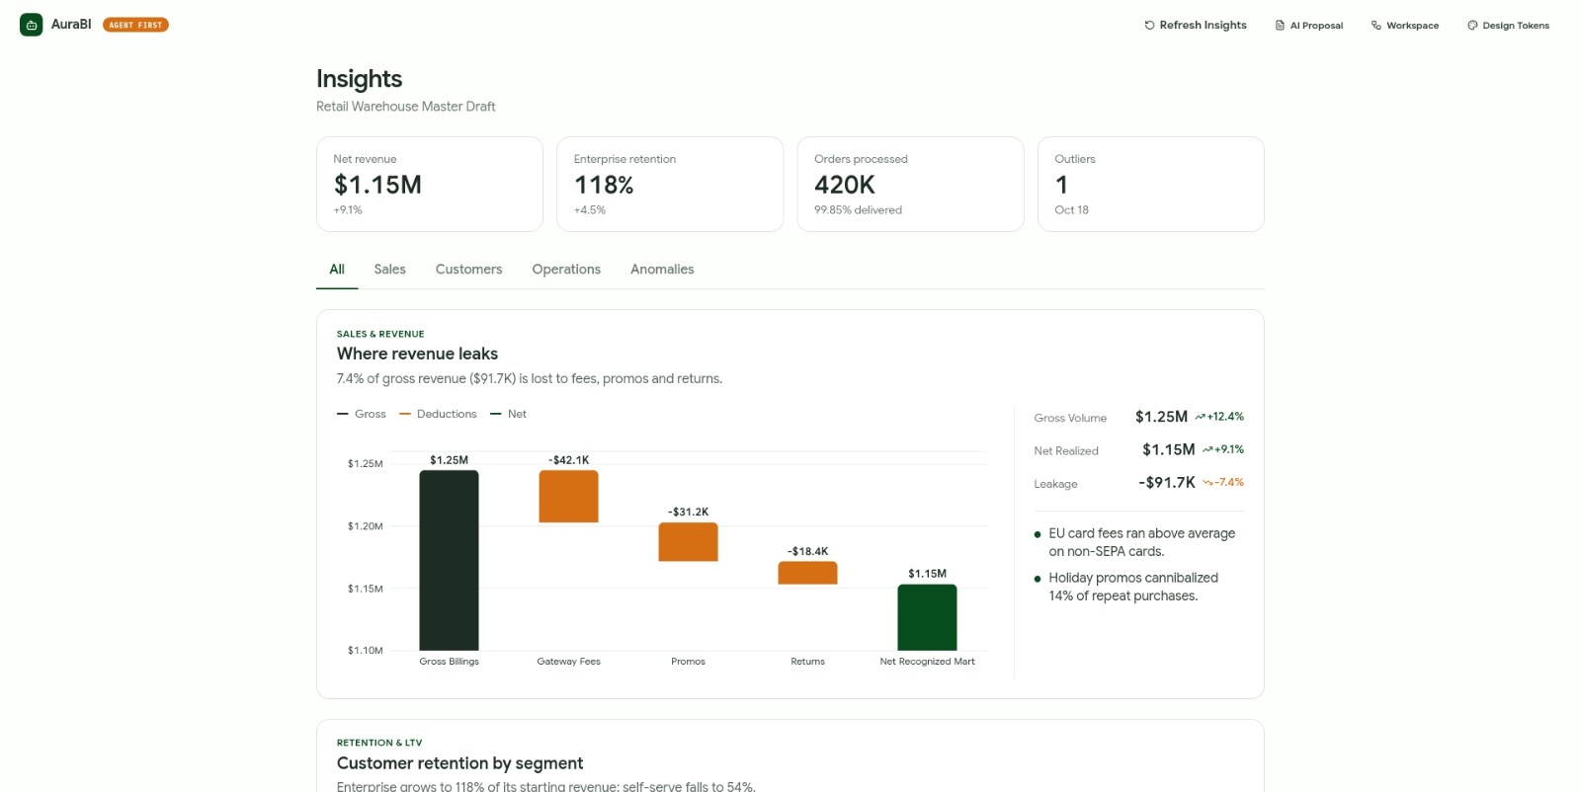
THE OPPORTUNITY
443,524
SMEs in Cameroon
Most navigate in the dark. Growing businesses have one data person doing the job of five.

Slide 3


THE PROBLEM
Answers require specialists.
Siloed Systems
Lengthy Pipelines
Blind Decisions
Data spread across platforms.
Days of specialist work.
Intuition instead of evidence.

Slide 4

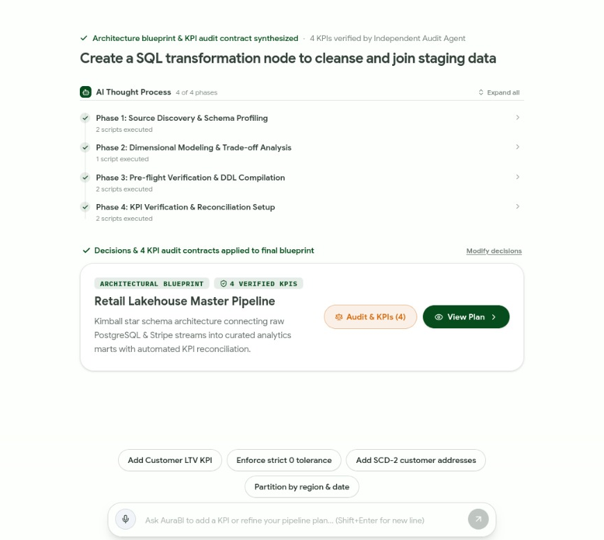
THE INNOVATION
The Agent-Driven BI Analyst.
AuraBI doesn't just guess numbers. It plans pipelines, writes compiled SQL, and proves its work.
Ask in plain words.
See the verified trace.

Slide 5

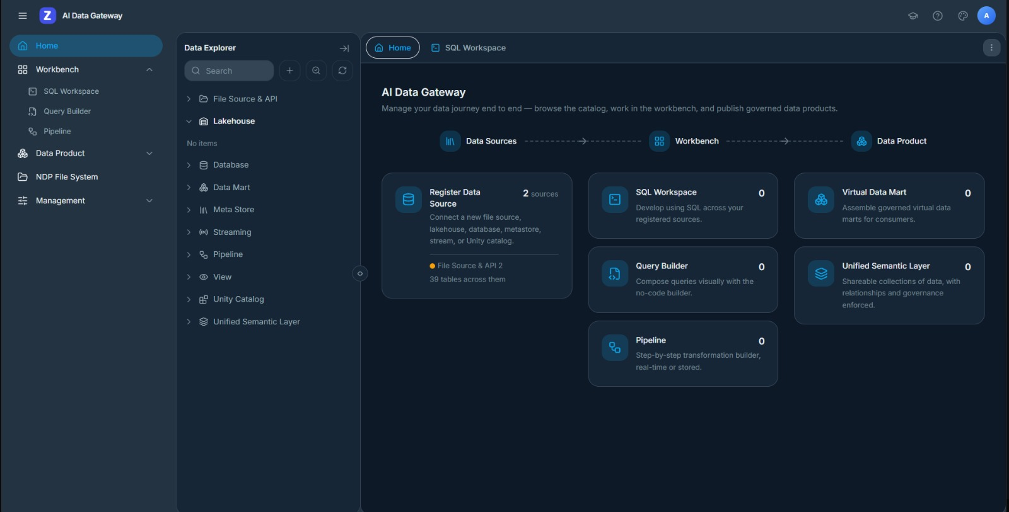
CORE TECHNOLOGY
Dynamic Data Reading.
Zetaris data fetching

Slide 6

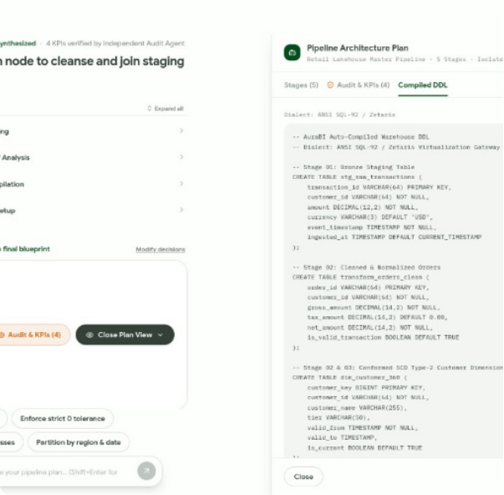
LIVE DEMO
Zero Hallucinations.
Plans: Nemotron maps the schema.
Executes: Zetaris runs the analytical SQL.
Proves: Guardian pauses for risky queries.

Slide 7



HOW IT WORKS
Specialized agent coordination.
Supervisor
Agent
Nemotron
Reasoning
Zetaris
Execution
Verified
Answer
User Question

Slide 8
HOW IT WORKS
Specialized agent coordination.
Supervisor
Agent
Nemotron
Reasoning
Zetaris
Execution
User Question
Verified
Answer

Slide 9
HOW IT WORKS
Specialized agent coordination.
Supervisor
Agent
Nemotron
Reasoning
Zetaris
Execution
User Question
Verified
Answer

Slide 10
HOW IT WORKS
Specialized agent coordination.
Supervisor
Agent
Nemotron
Reasoning
Zetaris
Execution
User Question
Verified
Answer

Slide 11
HOW IT WORKS
Specialized agent coordination.
User Question
Supervisor
Agent
Nemotron
Reasoning
Zetaris
Execution
Verified
Answer

Slide 12
MARKET TIMING
The $41.9B Agentic Shift.
91%
37%
Demand agentic AI capabilities.
Actively scaling agentic AI.

Slide 13
SPONSOR INTEGRATION
Uncompromising Architecture.
NVIDIA Nemotron
Zetaris
Meterless & Guardrails
Complex reasoning, task planning, and schema discovery via OpenAI-compatible adapter.
Supplies facts through high-velocity analytical query execution on federated data.
Secure runtime routing and explicit user-approval pauses for data modification.

Slide 14

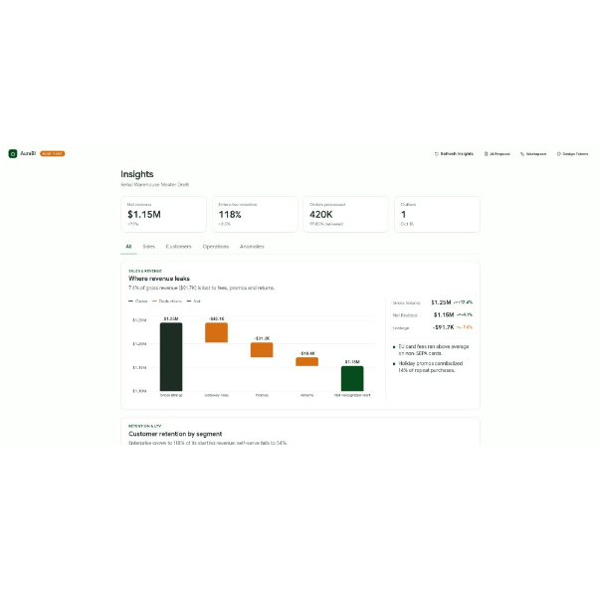
ROADMAP & IMPACT
Measuring confidence, not just AI usage.
PRIMARY METRICS
1. Answer Correctness
2. Evidence Completeness
3. Sub-second Execution
NEXT STEPS
Voice input, automated data profiling, and expanded audit agents.

Slide 15
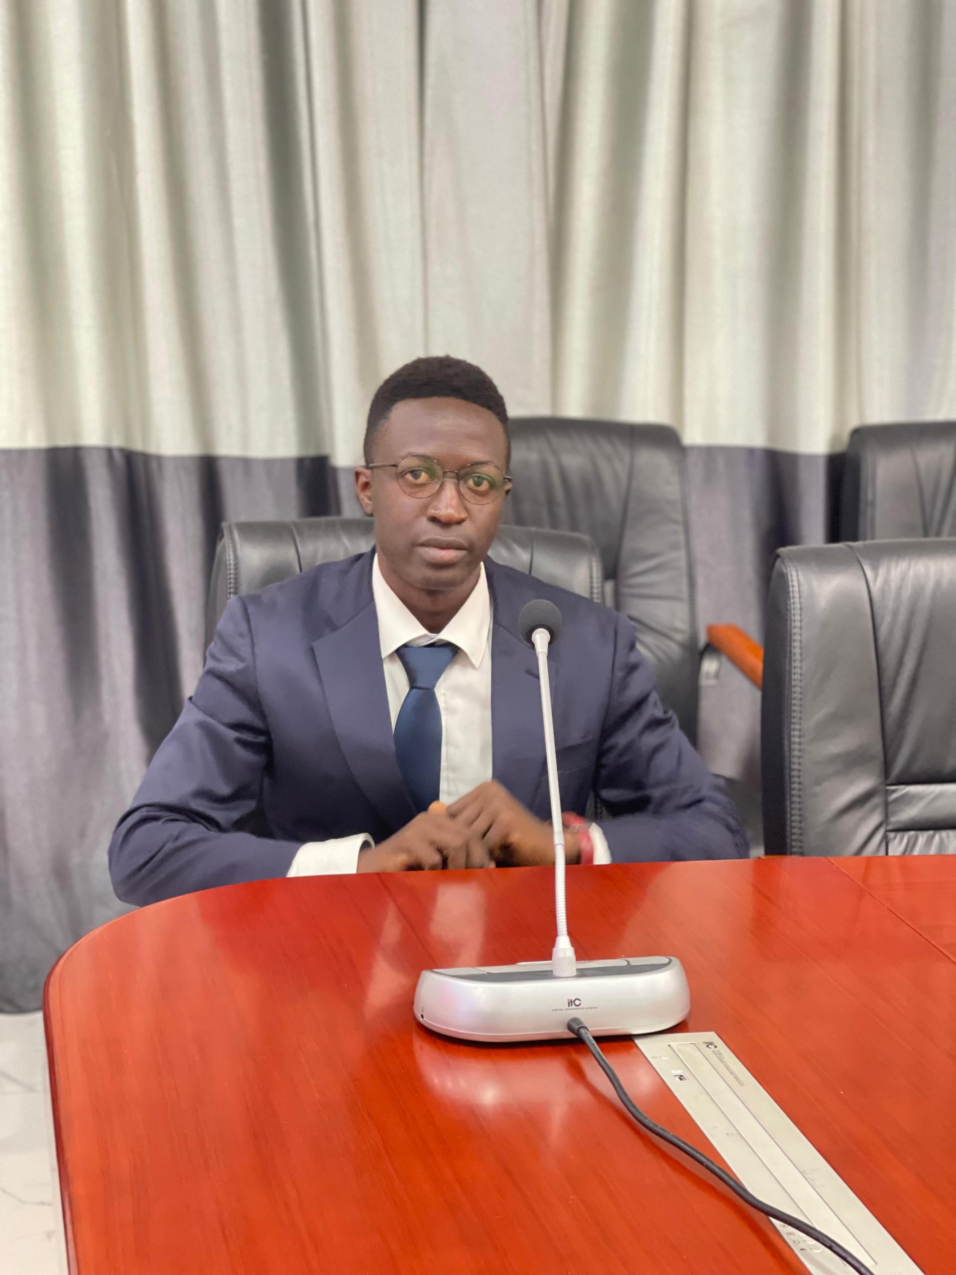

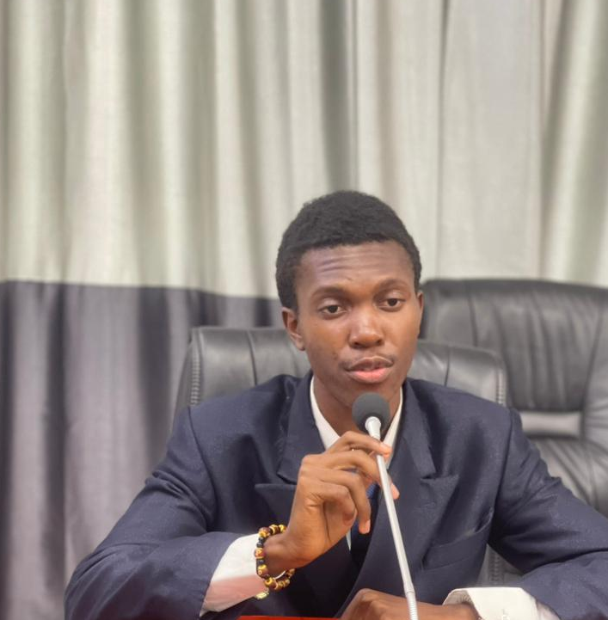
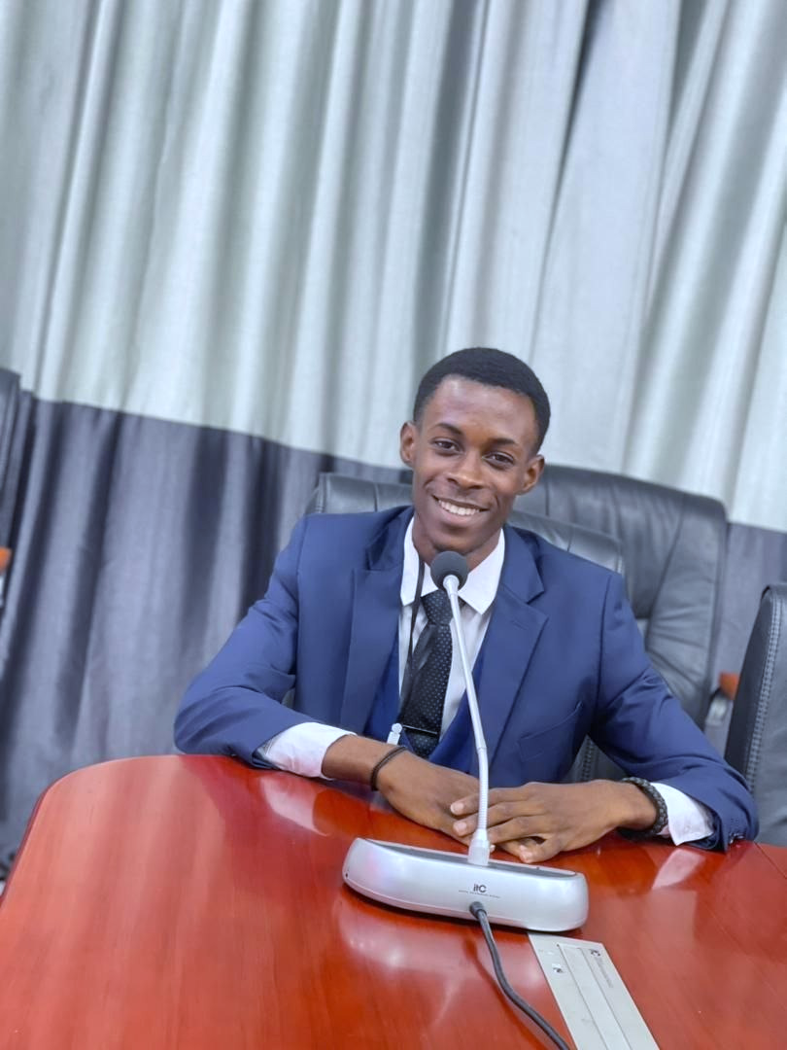

The TEAM

Slide 16
The TEAM
Jeffrey YOKO
Lowel KENNE
Junior MABENGUE
Ulrich
ETONDE
Christian
FONAYEN

Slide 17
AuraBI
Ask in plain words.
See the evidence..
Turn business questions into data-backed answers you can verify.

